Slide 1

Math's 5
Limits and continuity

Slide 2
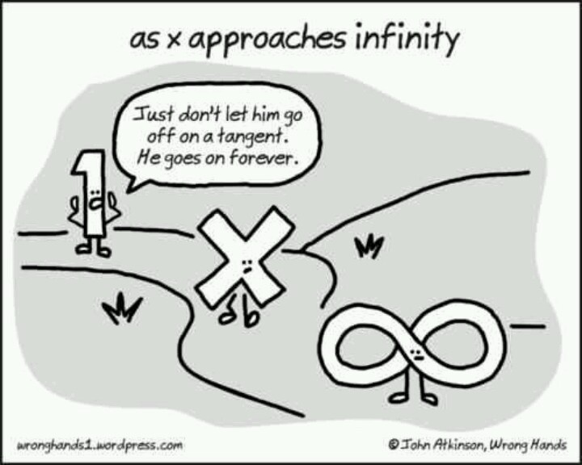
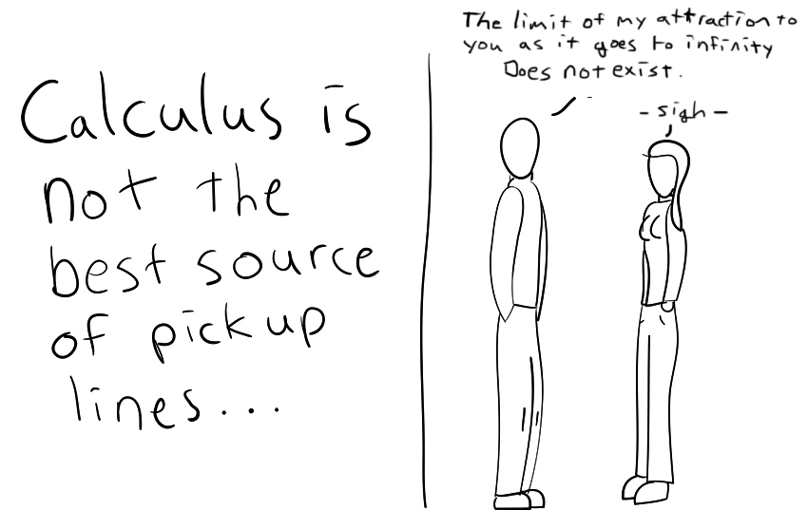
Limits

Slide 3
Limits
Limits are the value that a sequence or function approaches as the input approaches a value.
These are a fundamental basis of calculus.

Slide 4
Limits
Numbers are funny things, sometimes when we solve an equation the output is undefined.
Undefined numbers are things like 0/0 or infinity.
But functions have a series of outputs so we can look around the missing number to find out what it could be.

Slide 5

Limits
Lets look at:
$$\frac{\text{(}\text{x}\text{2}\text{ – 1) }}{\text{(}\text{x}\text{ – 1) }}$$

Slide 6

Limits
Lets look at:
$$\frac{\text{(}\text{x}\text{2}\text{ – 1) }}{\text{(}\text{x}\text{ – 1) }}$$
If we solve for x = 1 what happens.

Slide 7

Limits
Lets look at:
$$\frac{\text{(}\text{1}\text{2}\text{ – 1) }}{\text{(}\text{1}\text{ – 1) }}$$
If we solve for x = 1 what happens.

Slide 8

Limits
Lets look at:
$$\frac{\text{ 0} }{\text{ 0} }$$
If we solve for x = 1 what happens.
Damn 0/0 isn’t a number!

Slide 9
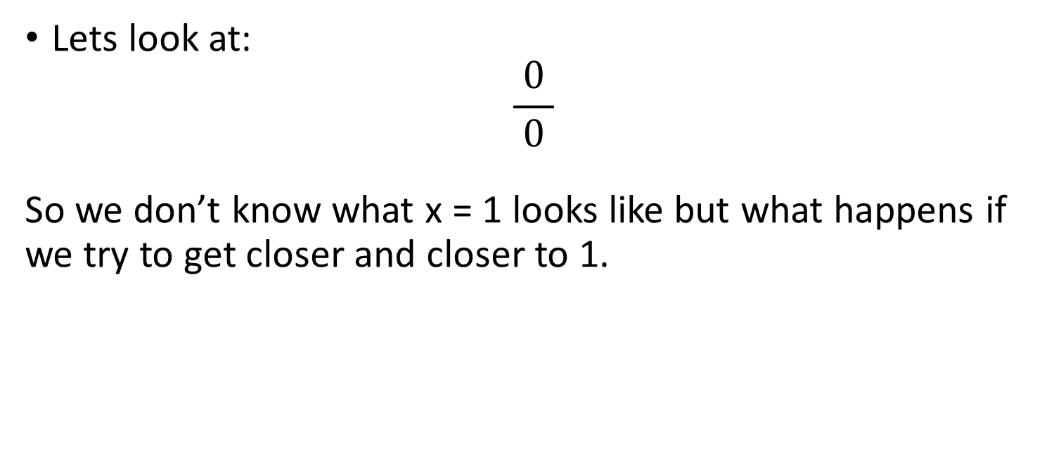
Limits
Lets look at:
$$\frac{\text{ 0} }{\text{ 0} }$$
So we don’t know what x = 1 looks like but what happens if we try to get closer and closer to 1.

Slide 10
Limits
x |  | (x² − 1)/(x − 1)
0.5 |  | 1.50000
0.9 |  | 1.90000
0.99 |  | 1.99000
0.999 |  | 1.99900
0.9999 |  | 1.99990
0.99999 |  | 1.99999
... |  | ...

Slide 11
Limits
We can see that as we get closer to 1 the output gets closer and closer to 2.
x |  | (x² − 1)/(x − 1)
0.5 |  | 1.50000
0.9 |  | 1.90000
0.99 |  | 1.99000
0.999 |  | 1.99900
0.9999 |  | 1.99990
0.99999 |  | 1.99999
... |  | ...

Slide 12
Limits
We can see that as we get closer to 1 the output gets closer and closer to 2.
We know that x=1 cannot be
determined but that it will be 2.
This means that as x approaches
1 the limit is 2.
x |  | (x² − 1)/(x − 1)
0.5 |  | 1.50000
0.9 |  | 1.90000
0.99 |  | 1.99000
0.999 |  | 1.99900
0.9999 |  | 1.99990
0.99999 |  | 1.99999
... |  | ...

Slide 13

Limits
We write limits like this:
$\lim_{n →c}{f\left(n\right)=L}$
Limits are just a fancy way of
writing y = but you can use it
even when there is no definitive
answer at that x value.
x |  | (x² − 1)/(x − 1)
0.5 |  | 1.50000
0.9 |  | 1.90000
0.99 |  | 1.99000
0.999 |  | 1.99900
0.9999 |  | 1.99990
0.99999 |  | 1.99999
... |  | ...

Slide 14

Limits
We write limits like this:
$\lim_{n →c}{f\left(n\right)=L}$
So for our equation:
$\lim_{x →1}{\frac{\text{(}\text{x}\text{2}\text{ – 1) }}{\text{(}\text{x}\text{ – 1) }}=2}$
x |  | (x² − 1)/(x − 1)
0.5 |  | 1.50000
0.9 |  | 1.90000
0.99 |  | 1.99000
0.999 |  | 1.99900
0.9999 |  | 1.99990
0.99999 |  | 1.99999
... |  | ...

Slide 15
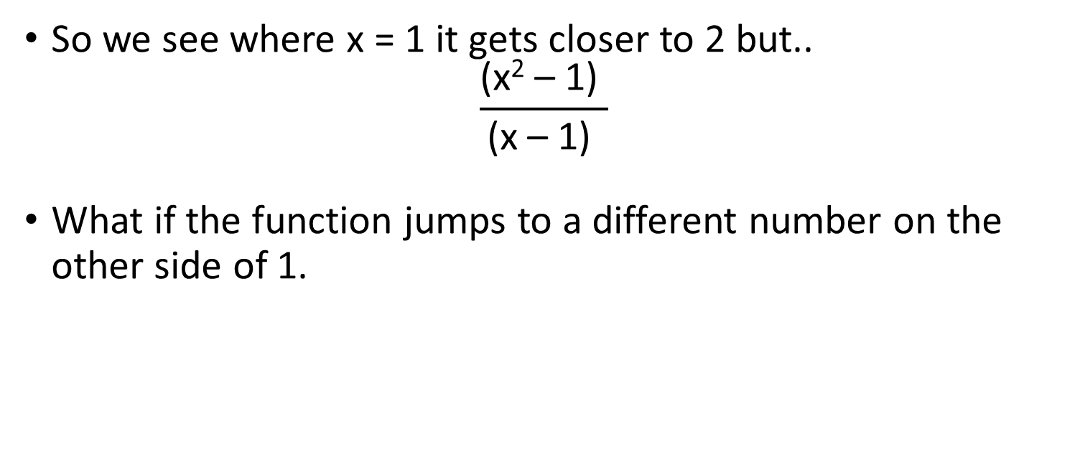
Limits
So we see where x = 1 it gets closer to 2 but..
$$\frac{\text{(}\text{x}\text{2}\text{ – 1) }}{\text{(}\text{x}\text{ – 1) }}$$
What if the function jumps to a different number on the other side of 1.

Slide 16
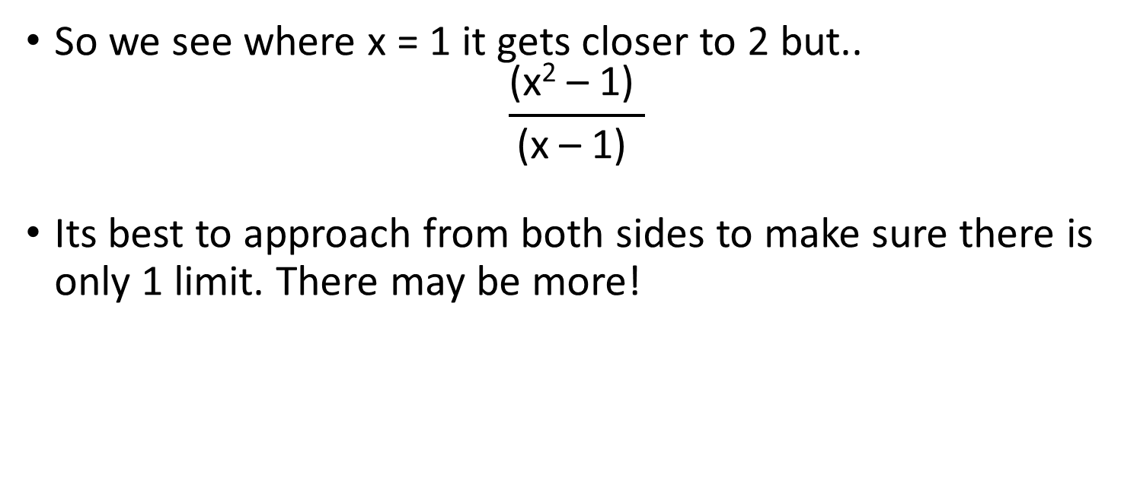
Limits
So we see where x = 1 it gets closer to 2 but..
$$\frac{\text{(}\text{x}\text{2}\text{ – 1) }}{\text{(}\text{x}\text{ – 1) }}$$
Its best to approach from both sides to make sure there is only 1 limit. There may be more!

Slide 17
Limits
So if we start at a value larger than 1 and work our way down we see that it also gets closer to 2.
x | (x² − 1)(x − 1)
1.5 | 2.50000
1.1 | 2.10000
1.01 | 2.01000
1.001 | 2.00100
1.0001 | 2.00010
1.00001 | 2.00001
... | ...

Slide 18
Limits
So if we start at a value larger than 1 and work our way down we see that it also gets closer to 2.
This is a good indication that 2 is the
limit.
x | (x² − 1)(x − 1)
1.5 | 2.50000
1.1 | 2.10000
1.01 | 2.01000
1.001 | 2.00100
1.0001 | 2.00010
1.00001 | 2.00001
... | ...

Slide 19
Limits
So if we start at a value larger than 1 and work our way down we see that it also gets closer to 2.
This is a good indication that 2 is the
limit.
x | (x² − 1)(x − 1)
1.5 | 2.50000
1.1 | 2.10000
1.01 | 2.01000
1.001 | 2.00100
1.0001 | 2.00010
1.00001 | 2.00001
... | ...

Slide 20
Limits
But functions can do weird things
They can make weird jumps and do funny things.

Slide 21
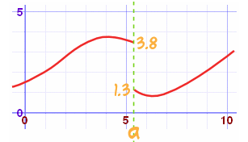
Limits
Lets take a look at a weird function.
*graph stolen from the internet. Do you know how hard it is to come up with and then plot a function that does this!

Slide 22
Limits
Lets take a look at a weird function.
At point a there is no answer!
But on either side the values
are different.
*graph stolen from the internet. Do you know how hard it is to come up with and then plot a function that does this!

Slide 23
Limits
Functions are funny, this could be thought of as two functions with different ranges.
In this case at point a the limit
can be the left hand limit or
the right hand limit.
*graph stolen from the internet. Do you know how hard it is to come up with and then plot a function that does this!

Slide 24

Limits
We denote the left hand limit with a – sign and the right hand limit with a + sign.
$\lim_{x →a^{−}}{f\left(x\right)=3.8}$
$\lim_{x →a^{+}}{f\left(x\right)=1.3}$
*graph stolen from the internet. Do you know how hard it is to come up with and then plot a function that does this!

Slide 25
Limits
Limits are just an equation to describe a value, like any term we use in algebra.
So we can treat it like a term in an algebraic equation but there are some rules we must follow.

Slide 26
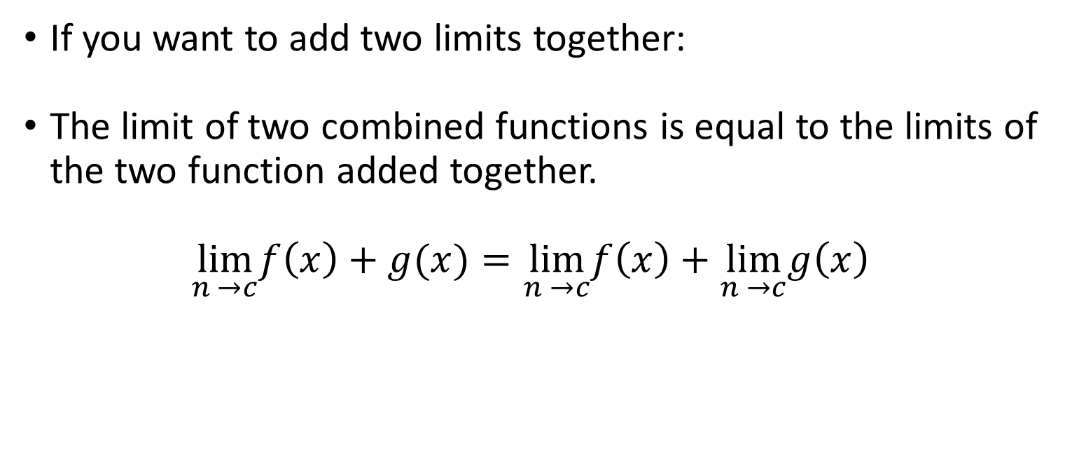
Limits
If you want to add two limits together:
The limit of two combined functions is equal to the limits of the two function added together.
$$\lim_{n →c}f\left(x\right)+g(x)=\lim_{n →c}f\left(x\right)+\lim_{n →c}g\left(x\right)$$

Slide 27
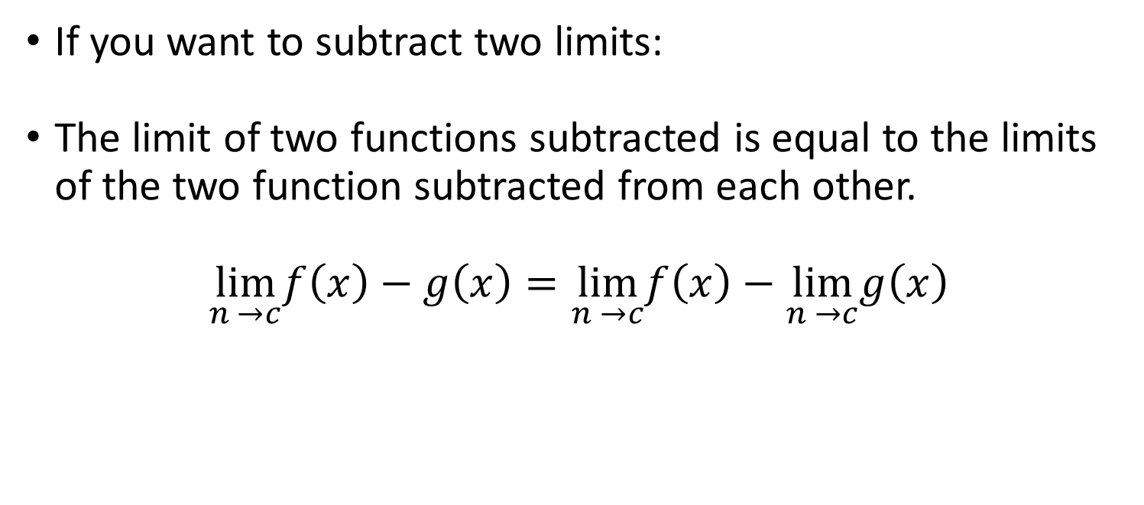
Limits
If you want to subtract two limits:
The limit of two functions subtracted is equal to the limits of the two function subtracted from each other.
$$\lim_{n →c}f\left(x\right)−g\left(x\right)=\lim_{n →c}f\left(x\right)−\lim_{n →c}g\left(x\right)$$

Slide 28
Limits
If you want to subtract two limits:
The limit of two functions subtracted is equal to the limits of the two function subtracted from each other.
$$\lim_{n →c}f\left(x\right)−g\left(x\right)=\lim_{n →c}f\left(x\right)−\lim_{n →c}g\left(x\right)$$

Slide 29
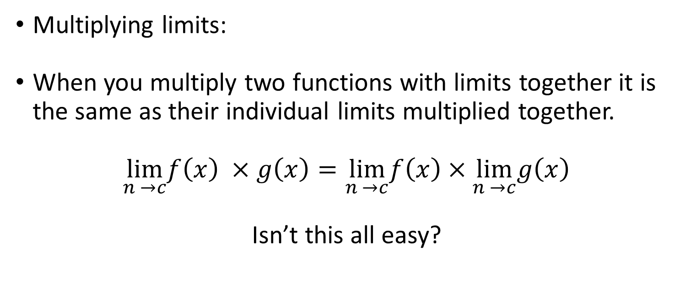
Limits
Multiplying limits:
When you multiply two functions with limits together it is the same as their individual limits multiplied together.
$$\lim_{n →c}f\left(x\right) ×g\left(x\right)=\lim_{n →c}f\left(x\right)×\lim_{n →c}g\left(x\right)$$
Isn’t this all easy?

Slide 30
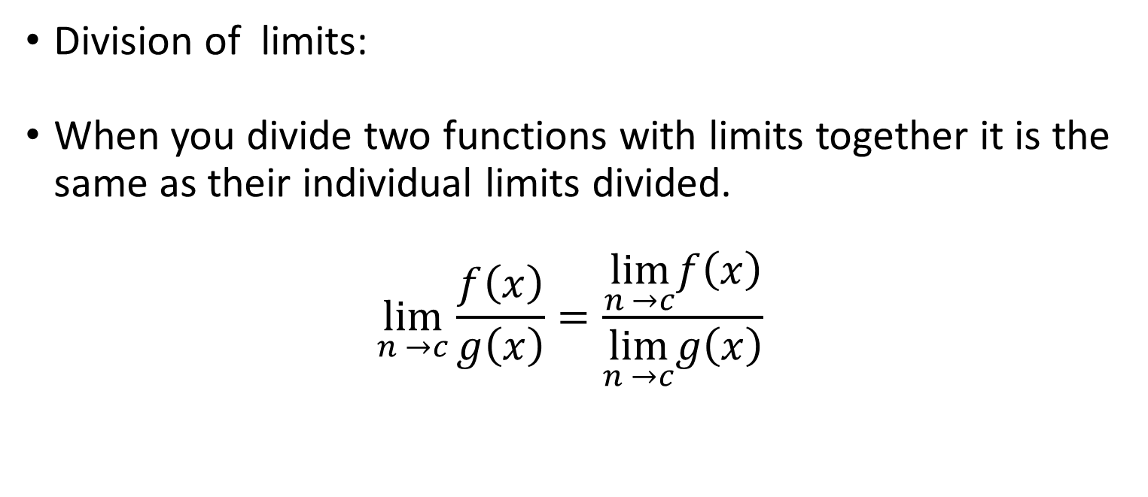
Limits
Division of limits:
When you divide two functions with limits together it is the same as their individual limits divided.
$$\lim_{n →c}\frac{f\left(x\right)}{g\left(x\right)}=\frac{\lim_{n →c}f\left(x\right)}{\lim_{n →c}g\left(x\right)}$$

Slide 31
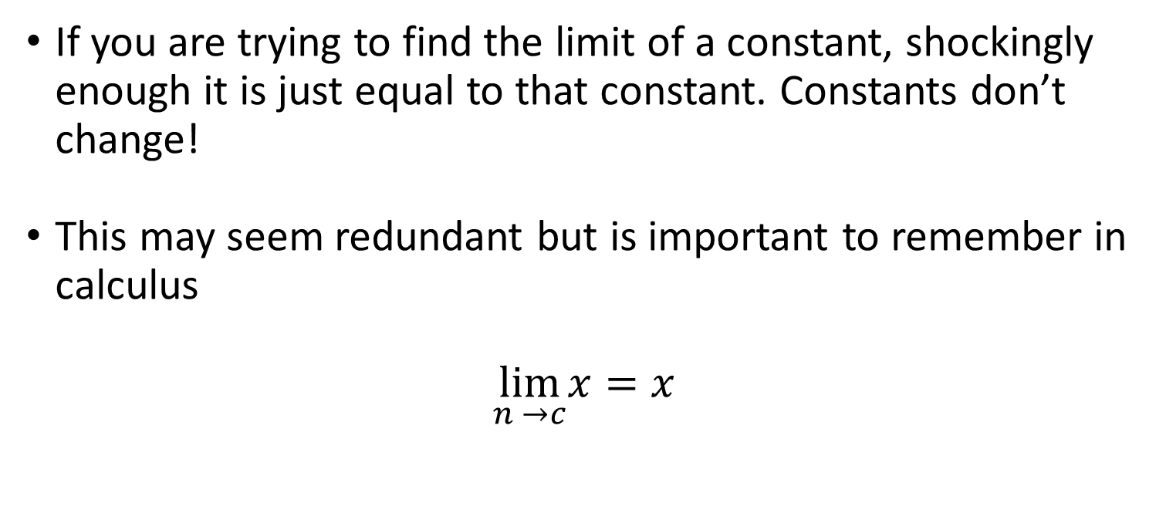
Limits
If you are trying to find the limit of a constant, shockingly enough it is just equal to that constant. Constants don’t change!
This may seem redundant but is important to remember in calculus
$$\lim_{n →c}x=x$$

Slide 32
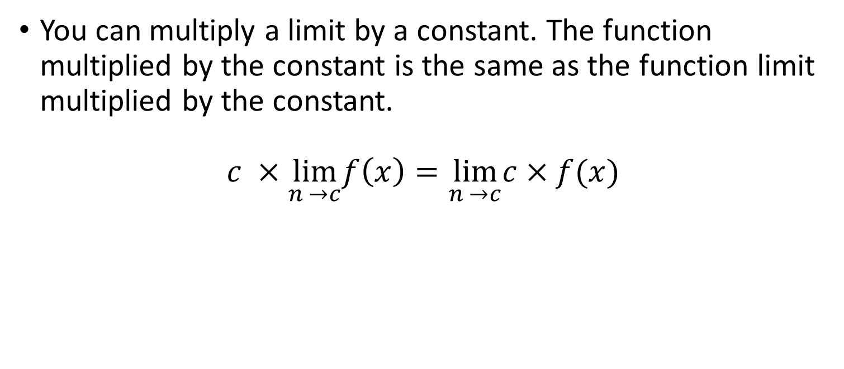
Limits
You can multiply a limit by a constant. The function multiplied by the constant is the same as the function limit multiplied by the constant.
$$c ×\lim_{n →c}f\left(x\right)=\lim_{n →c}c×f(x)$$

Slide 33
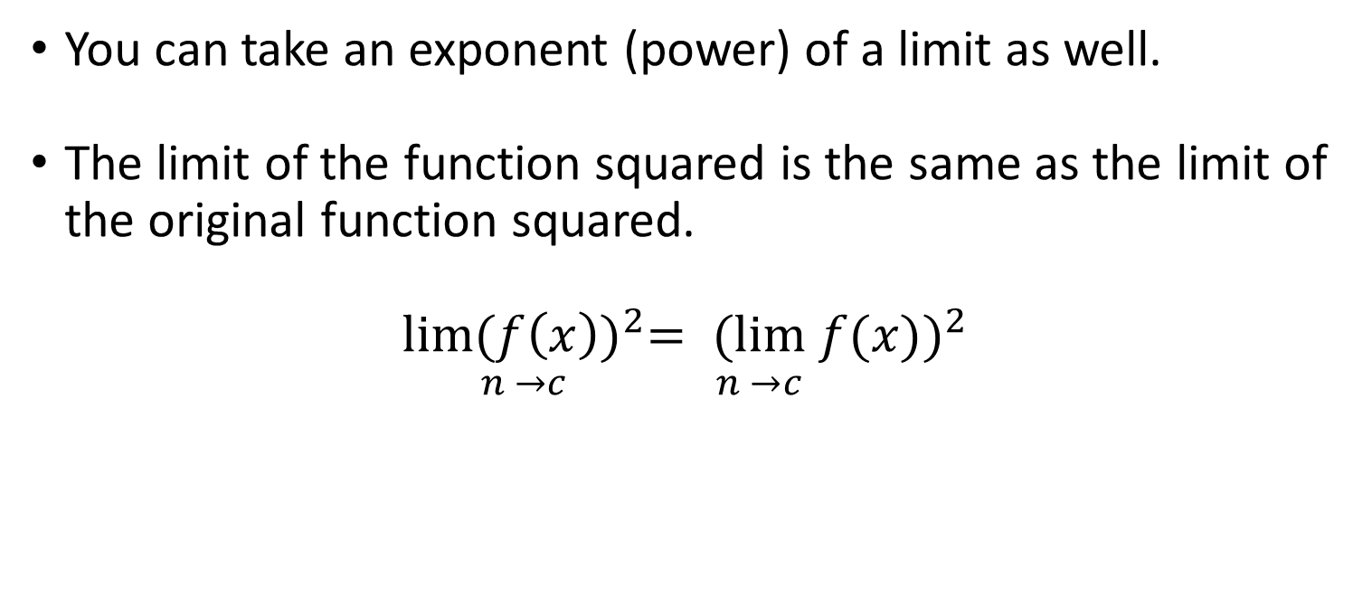
Limits
You can take an exponent (power) of a limit as well.
The limit of the function squared is the same as the limit of the original function squared.
$$\underset{n →c}{lim{(f\left(x\right))}^{2}}= {\underset{n →c}{(lim} f(x))}^{2}$$

Slide 34
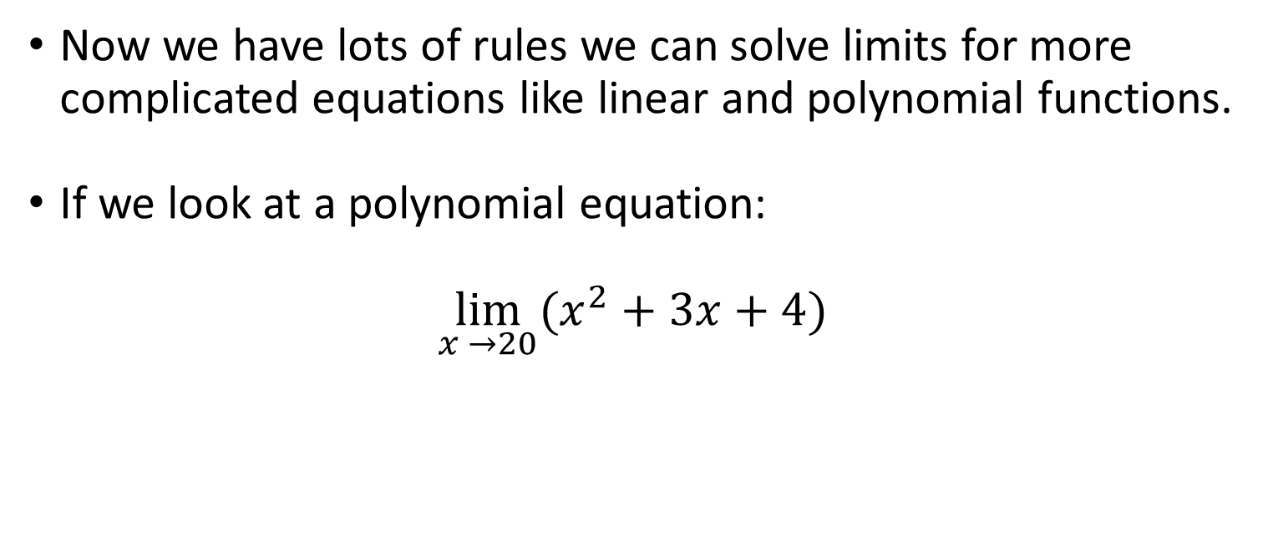
Limits
Now we have lots of rules we can solve limits for more complicated equations like linear and polynomial functions.
If we look at a polynomial equation:
$$\lim_{x →20}{(x^{2}+3x+4)}$$

Slide 35
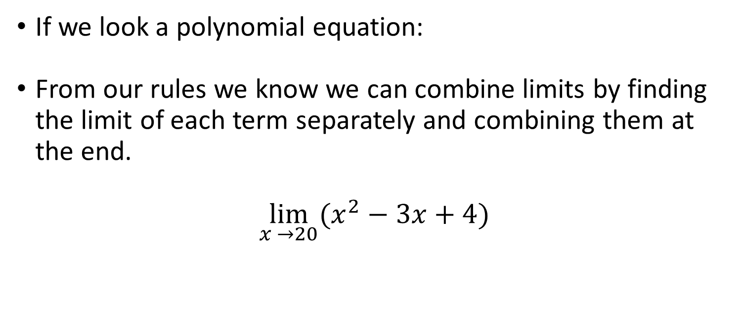
Limits
If we look a polynomial equation:
From our rules we know we can combine limits by finding the limit of each term separately and combining them at the end.
$$\lim_{x →20}{(x^{2}−3x+4)}$$

Slide 36
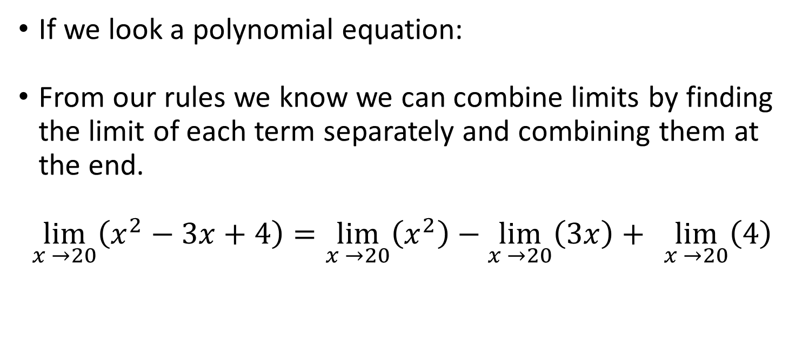
Limits
If we look a polynomial equation:
From our rules we know we can combine limits by finding the limit of each term separately and combining them at the end.
$$\lim_{x →20}\left(x^{2}−3x+4\right)=\lim_{x →20}\left(x^{2}\right)−\lim_{x →20}\left(3x\right)+ \lim_{x →20}\left(4\right)$$

Slide 37
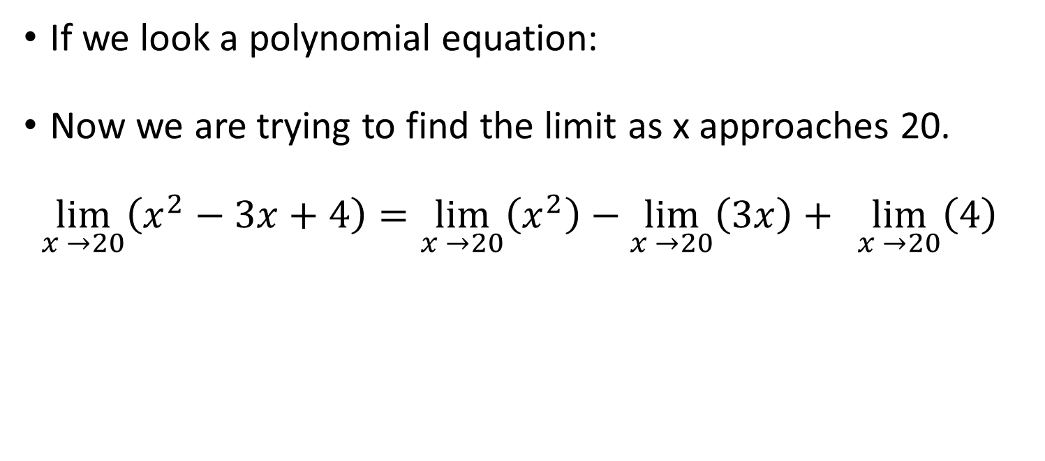
Limits
If we look a polynomial equation:
Now we are trying to find the limit as x approaches 20.
$$\lim_{x →20}\left(x^{2}−3x+4\right)=\lim_{x →20}\left(x^{2}\right)−\lim_{x →20}\left(3x\right)+ \lim_{x →20}\left(4\right)$$

Slide 38
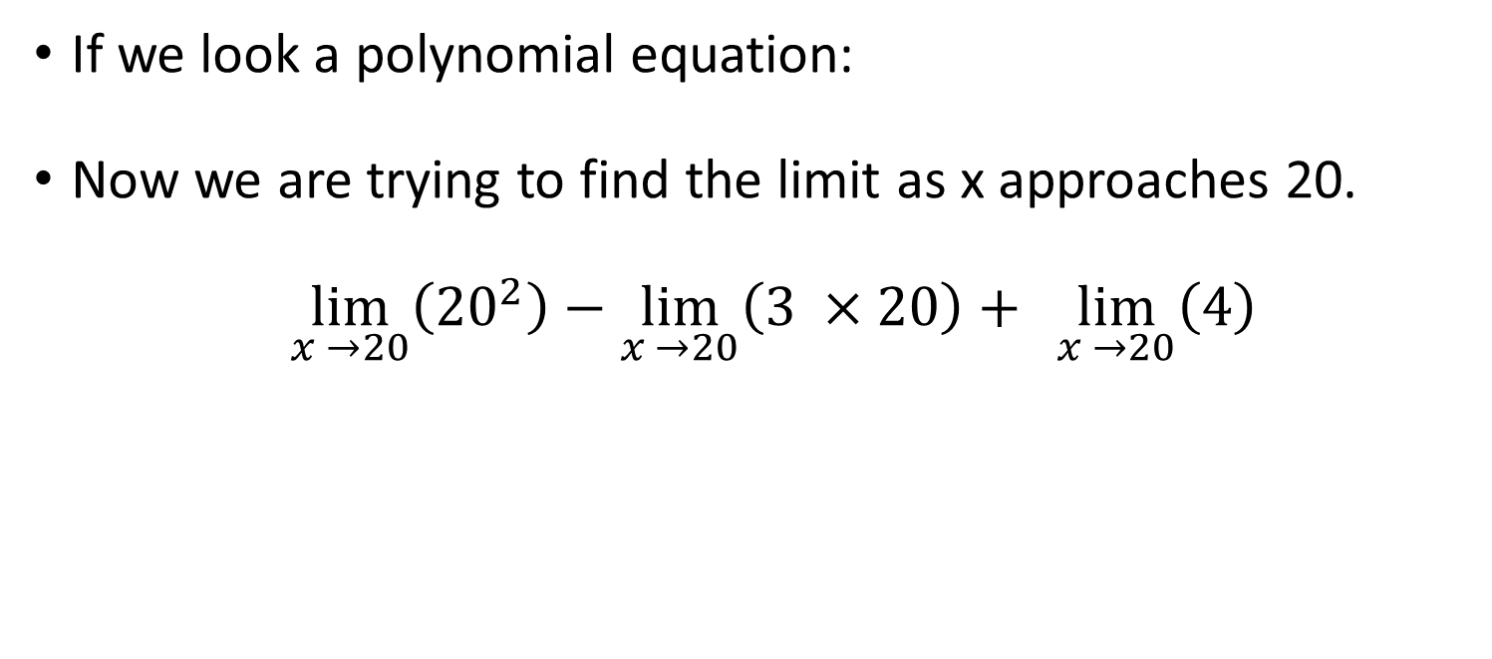
Limits
If we look a polynomial equation:
Now we are trying to find the limit as x approaches 20.
$${\lim_{x →20}\left({20}^{2}\right)−\lim_{x →20}\left(3 ×20\right)+ \lim_{x →20}\left(4\right) }$$

Slide 39
Limits
If we look a polynomial equation:
Now we are trying to find the limit as x approaches 20.
$${\lim_{x →20}\left({20}^{2}\right)−\lim_{x →20}\left(3 ×20\right)+ \lim_{x →20}\left(4\right) }$$

Slide 40
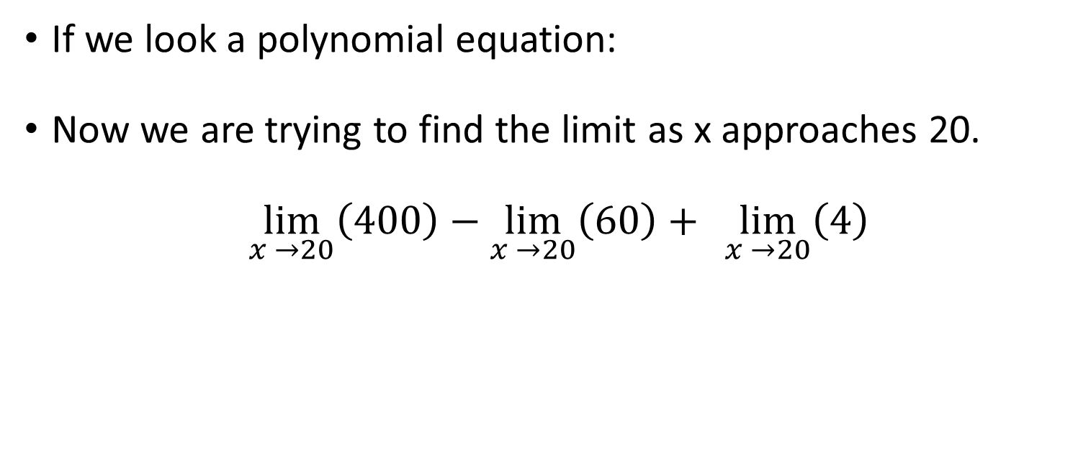
Limits
If we look a polynomial equation:
Now we are trying to find the limit as x approaches 20.
$${\lim_{x →20}\left(400\right)−\lim_{x →20}\left(60\right)+ \lim_{x →20}\left(4\right) }$$

Slide 41
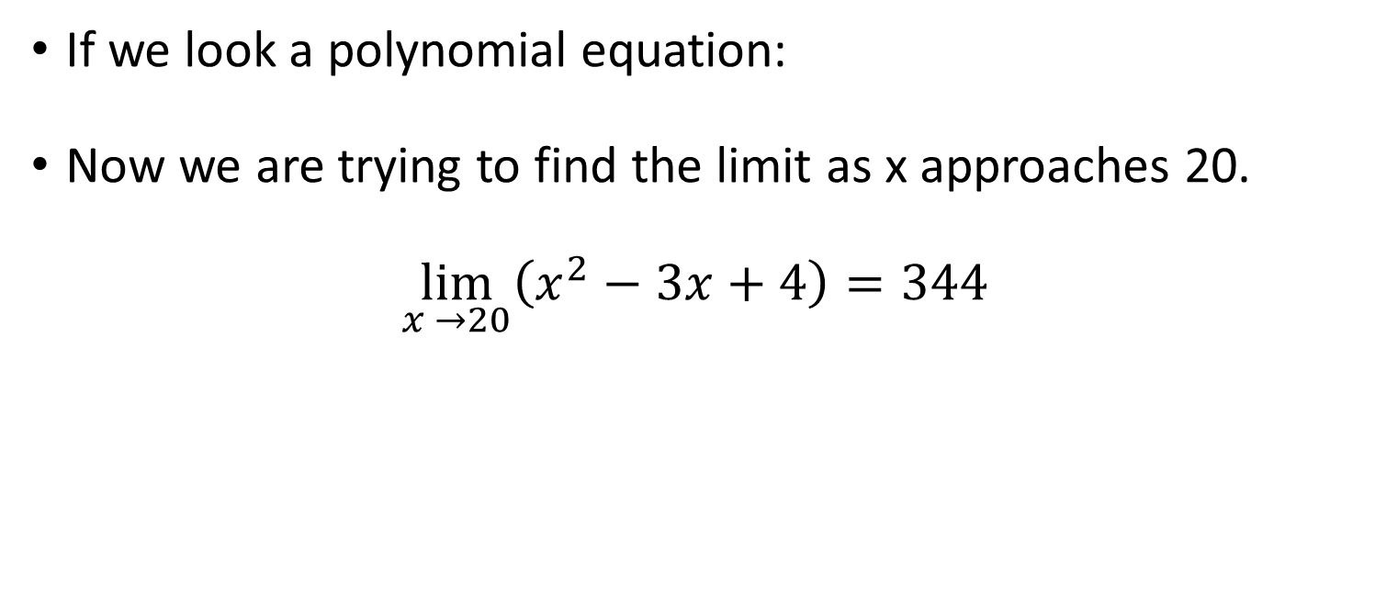
Limits
If we look a polynomial equation:
Now we are trying to find the limit as x approaches 20.
$\lim_{x →20}\left(x^{2}−3x+4\right)=344$

Slide 42
Limits
So we can solve limits like regular equations. Remember it is just a fancy way of saying y =.
Limits are useful when you plug in a number to an equation and it gives you a 0/0 or an imaginary number etc.
When this happens it is a bit time consuming to try every combination from both sides so there are some other things we can try.

Slide 43

Limits
Lets go back to the equation:
$$\lim_{x →1}{\frac{x^{2} −1}{x −1}}$$

Slide 44
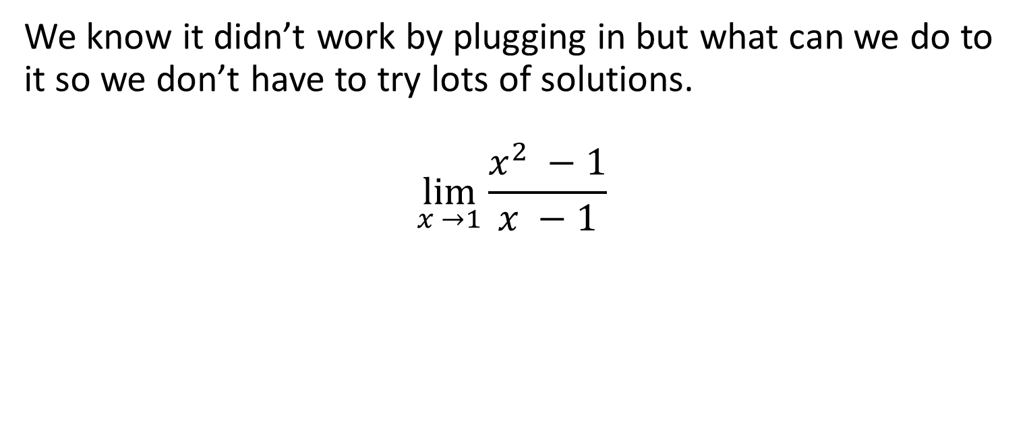
Limits
We know it didn’t work by plugging in but what can we do to it so we don’t have to try lots of solutions.
$$\lim_{x →1}{\frac{x^{2} −1}{x −1}}$$

Slide 45

Limits
Let’s factorise it:
$$\lim_{x →1}{\frac{x^{2} −1}{x −1}}$$

Slide 46

Limits
Let’s factorise it: 1² = 1
$$\lim_{x →1}{\frac{\left(x −1\right)(x+1)}{x −1}}$$

Slide 47

Limits
Oh look at that those cancel out
$$\lim_{x →1}{\frac{\left(x −1\right)(x+1)}{x −1}}$$

Slide 48

Limits
Oh look at that those cancel out
$$\lim_{x →1}{\frac{\left(x −1\right)(x+1)}{x −1}}$$

Slide 49

Limits
Oh look at that those cancel out
$$\lim_{x →1}{x+1}$$

Slide 50

Limits
Plug it in:
$$\lim_{x →1}{1+1}=2$$

Slide 51

Limits
And we have our original limit.
$$\lim_{x →1}{\frac{x^{2} −1}{x −1}}=2$$

Slide 52

Limits
Lets look at the equation:
$$\lim_{x →4}{\frac{2 − √x}{4 −x}}$$

Slide 53

Limits
Plug in the x value of 4
$$\lim_{x →4}{\frac{2 − √x}{4 −x}}$$

Slide 54

Limits
Plug in the x value of 4
$$\lim_{x →4}{\frac{2 − √4}{4 −4}}$$

Slide 55

Limits
Plug in the x value of 4
$$\lim_{x →4}{\frac{2 −2}{4 −4}}$$

Slide 56

Limits
Shit 0/0 again.
$$\lim_{x →4}{\frac{0}{0}}$$

Slide 57

Limits
Ok so what can we do to this to make it easier.
$$\lim_{x →4}{\frac{2 − √x}{4 −x}}$$

Slide 58
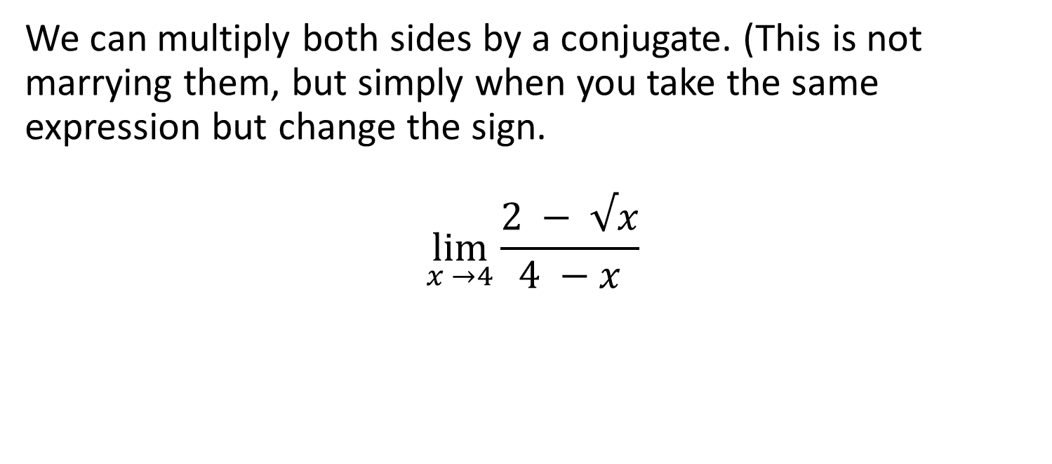
Limits
We can multiply both sides by a conjugate. (This is not marrying them, but simply when you take the same expression but change the sign.
$$\lim_{x →4}{\frac{2 − √x}{4 −x}}$$

Slide 59

Limits
We can multiply both sides by a conjugate.
$$\lim_{x →4}{\frac{2 − \sqrt{x}×2+ √x}{4 −x ×2+ √x}}$$

Slide 60

Limits
We can multiply both sides by a conjugate.
$$\lim_{x →4}{\frac{2^{2} − {√x}^{2}}{4 −x ×2+ √x}}$$

Slide 61

Limits
Simplify.
$$\lim_{x →4}{\frac{2^{2} − {√x}^{2}}{4 −x ×2+ √x}}$$

Slide 62

Limits
Simplify.
$$\lim_{x →4}{\frac{4 −x}{4 −x ×2+ √x}}$$

Slide 63

Limits
Simplify.
$$\lim_{x →4}{\frac{4 −x}{4 −x ×2+ √x}}$$

Slide 64

Limits
Simplify.
$$\lim_{x →4}{\frac{1}{2+ √x}}$$

Slide 65

Limits
Now we have a simplified equation we can plug numbers into.
$$\lim_{x →4}{\frac{1}{2+ √x}}$$

Slide 66

Limits
Now we have a simplified equation we can plug numbers into.
$$\lim_{x →4}{\frac{1}{2+ √x}}= \frac{1}{2+ √4}$$

Slide 67

Limits
Now we have a simplified equation we can plug numbers into.
$$\lim_{x →4}{\frac{1}{2+ √x}}= \frac{1}{2+2}$$

Slide 68

Limits
Now we have a simplified equation we can plug numbers into.
$$\lim_{x →4}{\frac{1}{2+ √x}}= \frac{1}{4}$$

Slide 69

Limits
Now we have a simplified equation we can plug numbers into.
$$\lim_{x →4}{\frac{1}{2+ √x}}=0.25$$

Slide 70

Limits
Lets compare this to a close number to 4 in the original
$$\lim_{x →4}{\frac{1}{2+ √x}}=0.25$$
$$\lim_{x →4}{\frac{2 − √x}{4 −x}}= \frac{2 − √3.9}{4 −3.9}$$

Slide 71

Limits
Lets compare this to a close number to 4 in the original
$$\lim_{x →4}{\frac{1}{2+ √x}}=0.25$$
$$\lim_{x →4}{\frac{2 − √x}{4 −x}}= \frac{2 −1.97}{4 −3.9}$$

Slide 72

Limits
Lets compare this to a close number to 4 in the original
$$\lim_{x →4}{\frac{1}{2+ √x}}=0.25$$
$$\lim_{x →4}{\frac{2 − √x}{4 −x}}= \frac{0.03}{0.1}$$

Slide 73

Limits
Pretty close
$$\lim_{x →4}{\frac{1}{2+ √x}}=0.25$$
$$\lim_{x →4}{\frac{2 − √x}{4 −x}}=0.3$$

Slide 74
Limits
Many limits problems can be more quickly solved by simplifying the equation in some way and solving then.
Expand the brackets, factorise, conjugate etc. to see if you can turn it into an equation where you can work out the limit at that point.

Slide 75
Formal definitions
When we use limits we are saying that as x approaches a number y gets close to a value. But we have been writing it with = when it is not actually = but close to.
We need a mathematical way of writing this but then we come up with problems of close to what? And what about positive or negative? Do we care?

Slide 76
Formal definitions
When we use limits we are saying that as x approaches a number y gets close to a value. But we have been writing it with = when it is not actually = but close to.
How can we say define how close two numbers are? If we subtract we get problems with negatives. Can you be negatively close to something?

Slide 77
Formal definitions
What we need is a way of saying I don’t care about positive or negative just how far it is from 0 in either direction.
We call this the absolute value, the absolute value of -10 is just |10|. We use the | | symbols to denote the absolute value of something.

Slide 78

Formal definitions
This is important for limits of functions as the output of a function can beyond the limit. In our previous function:
$$\frac{\text{(}\text{x}\text{2}\text{ – 1) }}{\text{(}\text{x}\text{ – 1) }}$$
The limit was 2 at x = 4 but when we go beyond x = 4 we still want to compare the difference to the limit.

Slide 79
Formal definitions
If we use absolute values we can determine how close a value is to the limit whether it is negative or not.
So as a x approaches the “limit point” the f(x) approaches the limit or:
When |x – c| is low |f(x) – L| is low
Where c is the limit point and L is the limit.

Slide 80
Formal definitions
When |x – c| is low |f(x) – L| is low
But when it is low is not very mathematical sounding. But fortunately in maths we can say when something is smaller.
But smaller than what? Well we don’t actually know the values but we know they exist so lets put in some algebra.

Slide 81
Formal definitions
When |x – c| is low |f(x) – L| is low
But smaller than what? Well we don’t actually know the values but we know they exist so lets put in some algebra.
Lets call it δ and ε (because that’s what its normally called)

Slide 82
Formal definitions
When |x – c| is low |f(x) – L| is low
So we can say |f(x) – L| < ε when|x – c| < δ (we swap it round when the when moves)

Slide 83
Formal definitions
|f(x) – L| < ε when|x – c| < δ
However there are some conditions on this:
It is true for any ε > 0
δ exists and is > 0
X is not equal to c

Slide 84
Formal definitions
|f(x) – L| < ε when|x – c| < δ
So with our conditions this means:
For any ε > 0, there is a δ > 0 so that |f(x) – L| < ε when 0 <|x – c| < δ

Slide 85
Formal definitions
|f(x) – L| < ε when|x – c| < δ
So with our conditions this means:
For any ε > 0, there is a δ > 0 so that |f(x) – L| < ε when 0 <|x – c| < δ
We can use this notation to show that a normal limit function is true

Slide 86

Formal definitions
|f(x) – L| < ε when|x – c| < δ
When we have a limit function:
$$\lim_{x →3}{2x+4=10 }$$
We can prove it using our formal definition.

Slide 87

Formal definitions
|f(x) – L| < ε when|x – c| < δ
When we have a limit function:
$$\lim_{x →3}{2x+4=10 }$$
We want to show that 0 <|x – 3| < δ can become
|(2x+4) – 10|< ε

Slide 88
Formal definitions
|f(x) – L| < ε when|x – c| < δ
When we have a limit function:
$$\lim_{x →3}{2x+4=10 }$$
We want to show that 0 <|x – 3| < δ can become
|(2x+4) – 10|< ε

Slide 89

Formal definitions
$$\lim_{x →3}{2x+4=10 }$$
Lets start by simplifying this equation
|(2x+4) – 10|< ε

Slide 90

Formal definitions
$$\lim_{x →3}{2x+4=10 }$$
Lets start by simplifying this equation
|(2x-6)|< ε

Slide 91

Formal definitions
$$\lim_{x →3}{2x+4=10 }$$
Lets start by simplifying this equation
|2(x-3)|< ε

Slide 92

Formal definitions
$$\lim_{x →3}{2x+4=10 }$$
Lets start by simplifying this equation
|(x-3)|< ε/2

Slide 93

Formal definitions
$$\lim_{x →3}{2x+4=10 }$$
Lets start by simplifying this equation
|(x-3)|< ε/2
Hey look we have |x – 3|

Slide 94

Formal definitions
$$\lim_{x →3}{2x+4=10 }$$
Lets start by simplifying this equation
|(x-3)|< ε/2
So now we should try this as our value of δ

Slide 95
Formal definitions
$$\lim_{x →3}{2x+4=10 }$$
Lets start by simplifying this equation
|(x-3)|< ε/2
So now we should try this as our value of δ

Slide 96

Formal definitions
$$\lim_{x →3}{2x+4=10 }$$
0 <|x – 3| < δ

Slide 97

Formal definitions
$$\lim_{x →3}{2x+4=10 }$$
0 <|x – 3| < ε/2

Slide 98

Formal definitions
$$\lim_{x →3}{2x+4=10 }$$
0 <|x – 3| < ε/2
Oh look at that it’s the same equation. Thus we have proved our limit statement.

Slide 99

Power series
We’ve covered series in the past and we found the equations that describe the series. These equations are in essence functions that produce the series.
Everything is a function if you are brave enough!
You take each term and do something to it make the next term in the series, sounds like a function to me.

Slide 100
Power series
The crucial difference is a series produces many outputs when you put a single x value into it.
This means in function terms the x axis of the function of a series is actually the term i.e. n.
Or a function can be a series, so you can run through infinite series of x values in a function putting them all into an infinite series!

Slide 101

Power series
A power series is just a series that’s formula takes the specific form of:
$$\sum_{n=0}^{∞}{a_{n}{(x −c)}^{n}}=a_{0}+ a_{1} {(x −c)}^{1}+a_{2} {(x −c)}^{2}+…$$
Where a is the coefficient of the term and c is a constant.
The coefficient or the constant can be 0!

Slide 102
Power series
If we remember limits a limit is the value that a function approaches as the input approaches another value.
With a power series the series can converge at a point which is equivalent to a limit for the series.
It may only converge for some values of x that you put into it and not others, or maybe even for none. This is called divergent.

Slide 103
Power series
So in limit terms a power series converges at point limit point c like in a function limit.
However as a series can continue beyond this point to infinity but has converged at point c.
So in this case we use r the radius of convergence where any numbers above r are the same.

Slide 104
Power series
So when |x – c| < r the series has converged and when |x – c| > r the series has diverged.

Slide 105

Power series
So if we take a function that simplifies into a power series:
$$f\left(x\right)= \sum_{n=0}^{∞}{a_{n}{(x −c)}^{n}}$$
We can treat it like any other function, adding, subtracting multiplying and dividing. The maths is complicated though.

Slide 106

Power series
If we want to combine two power series:
$$f\left(x\right)= \sum_{n=0}^{∞}{a_{n}{(x −c)}^{n}}$$
$$g\left(x\right)= \sum_{n=0}^{∞}{b_{n}{(x −c)}^{n}}$$

Slide 107

Power series
We just use our expand the brackets rules
$$f\left(x\right)+g(x)= \sum_{n=0}^{∞}{{(a}_{n}+b_{n}){(x −c)}^{n}}$$

Slide 108
Continuity
We have seen functions with holes or jumps before and worked out there limits but we have also worked out the limits involved in functions where it can be defined.
If a function produces outputs that always exist i.e. there are no holes or jumps it is termed as continuous.
If not it is discontinuous.

Slide 109
Continuity
A limit can arise when there is a hole, a jump or a trend towards infinity.
If this happens this means a function is not continuous.
But a function can be continuous on either side of it.

Slide 110

Continuity
To decide if a function is continuous at a point all you do is plug that value into the function and see if it exists.
Often it will be obvious when there is a limit as you can get a divide by 0.
$$\frac{1}{x}$$

Slide 111

Continuity
To decide if a function is continuous at a point all you do is plug that value into the function and see if it exists.
Often it will be obvious when there is a limit as you can get a divide by 0.
$$\frac{1}{x}$$
There is an obvious limit at x = 0.

Slide 112

Continuity
Lets show that
$$f\left(x\right)=\frac{x+1}{x −2}$$
Is continuous at x = 3

Slide 113

Continuity
Lets show that
$$f\left(x\right)=\frac{3+1}{3 −2}$$
Is continuous at x = 3

Slide 114

Continuity
Lets show that
$$f\left(3\right)=\frac{4}{1}$$
Is continuous at x = 3

Slide 115

Continuity
Lets show that
$$f\left(3\right)=1$$
Is continuous at x = 3

Slide 116

Continuity
Lets show that
$$f\left(3\right)=1$$
Is continuous at x = 3
Because x = 3 exists it is continuous at x = 3.
However

Slide 117

Continuity
$$f\left(x\right)=\frac{x+1}{x −2}$$
Is not continuous at x = 2

Slide 118

Continuity
$$f\left(x\right)=\frac{2+1}{2 −2}$$
Is not continuous at x = 2

Slide 119

Continuity
$$f\left(x\right)=\frac{3}{0}$$
Is not continuous at x = 2

Slide 120

Continuity
$$f\left(x\right)=\frac{3}{0}$$
Is not continuous at x = 2
There is a limit at x = 2

Slide 121

Continuity
$$f\left(x\right)=\frac{3}{0}$$
Is not continuous at x = 2
There is a limit at x = 2
So we can say that f(x) is continuous at values above 2 or below 2.

Slide 122


